Slide 1
Area Coverage with Unmanned Aerial Vehicles
Zichen “Charles” Zhang

Slide 2
Area Coverage with Unmanned Aerial Vehicles
Environment Setup
Tabular Q Learning
Graph Based MDP Q Learning
Multi-Agent Q Learning
Actor Critic using Kronecker-Factored Trust Region(ACKTR)
Conclusion and Future Work
Acknowledge

Slide 3
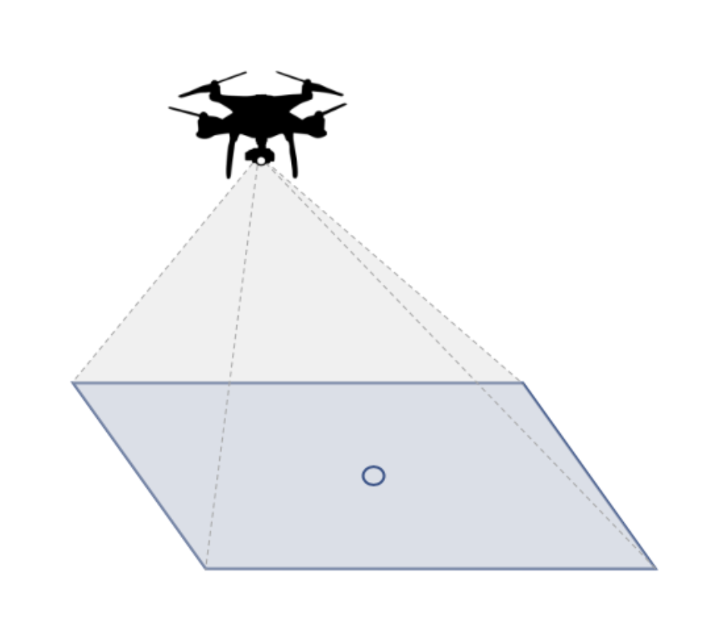
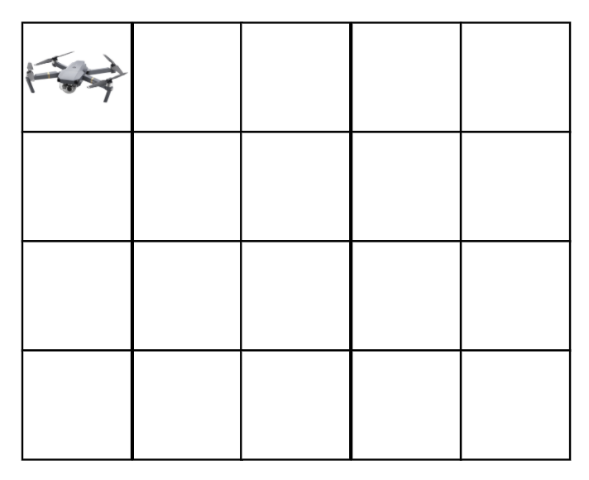
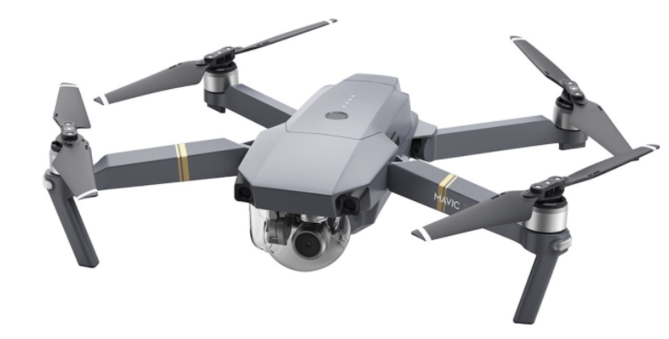
Environment Setup
Visit all cells and come back to the launch position(Hamiltonian Circuit) for single agent coverage
Visit all cells from two different launch positions for multiple agents coverage
←(second agent)
Projected area of UAV
a simple 4x5 gridworld starting at (0,0)

Slide 4
Gym Environment Setup in the GridWorld
Step(action(s)):
“””
core structure for step of Single/Double Agent(s), for more, LINK
return (new observation, reward, done, info)
“””
is_Visited = False
Update actions to get current State(1 or 2 coordinate(s))
for position in State: # iteration for double agents
If position out of bound:
return new_observation, -1, False, { }
Else if position in {visited_positions}:
is_Visited = True
Add current state in STEPS
if visited:
return new_observation, 0, True, {}
else if all grids has been visited:
Feed global rewards(GR)
return new_observation, GR, True, { }
else:
return new_observation, 1, False, { }
Basic Actions:
Left = 0
Right = 1
Up = 2
Down = 3
Actions in gridworld:
Left = (0,-1)
Right = (0,1)
Up = (-1,0)
Down = (1,0)
Action Space for single agent
spaces.Discrete(1)
= Actions
Action Space for double agents
spaces.Discrete(16)
= (Actions) × (Actions)

Slide 5
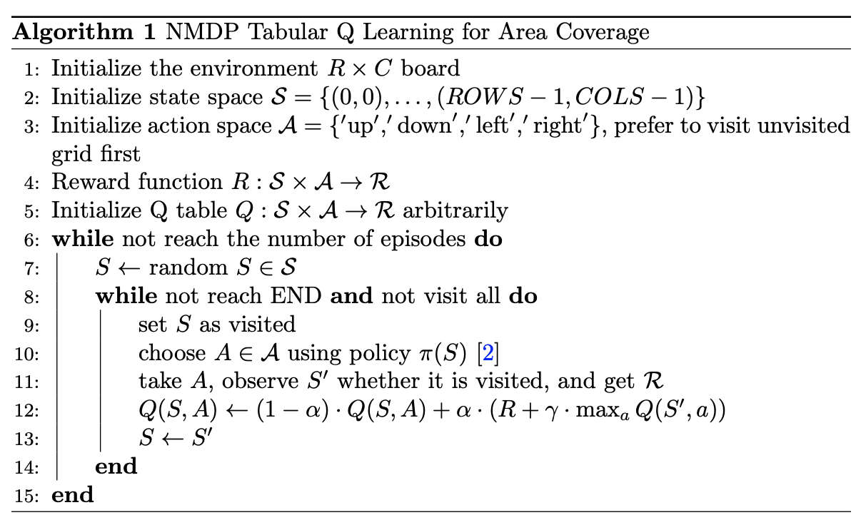
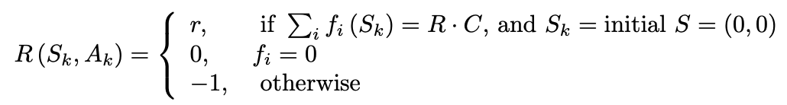


Tabular Q Learning

Slide 6
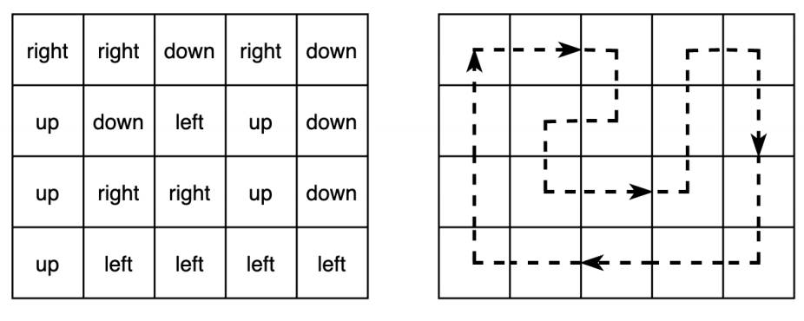
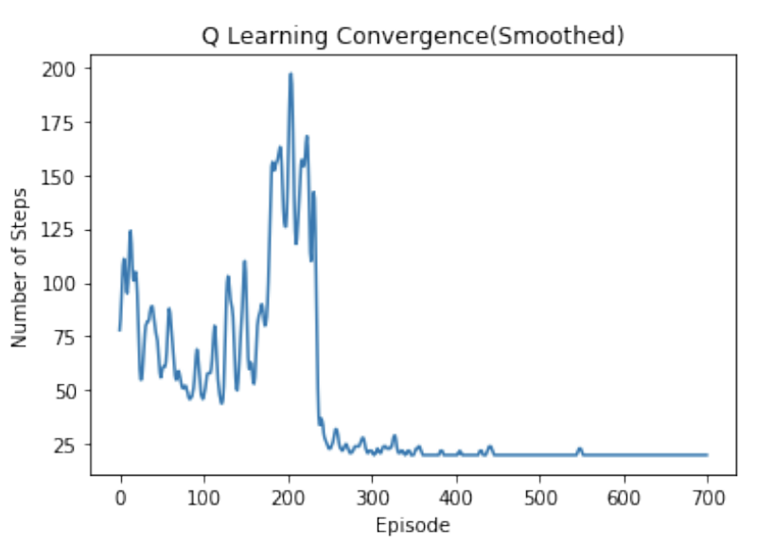
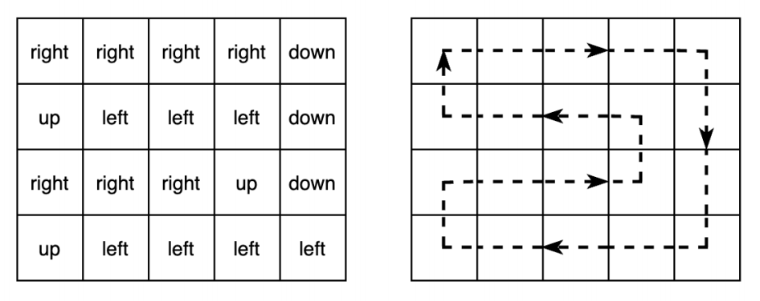
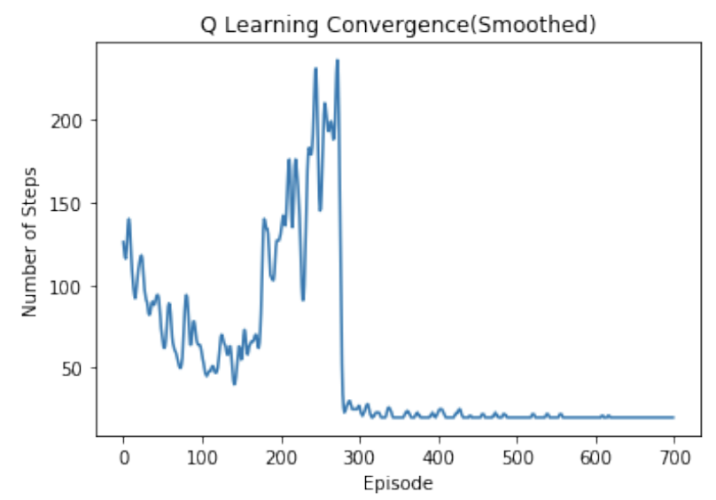
NMDP Tabular Q Learning Examples Results
Link

Slide 7
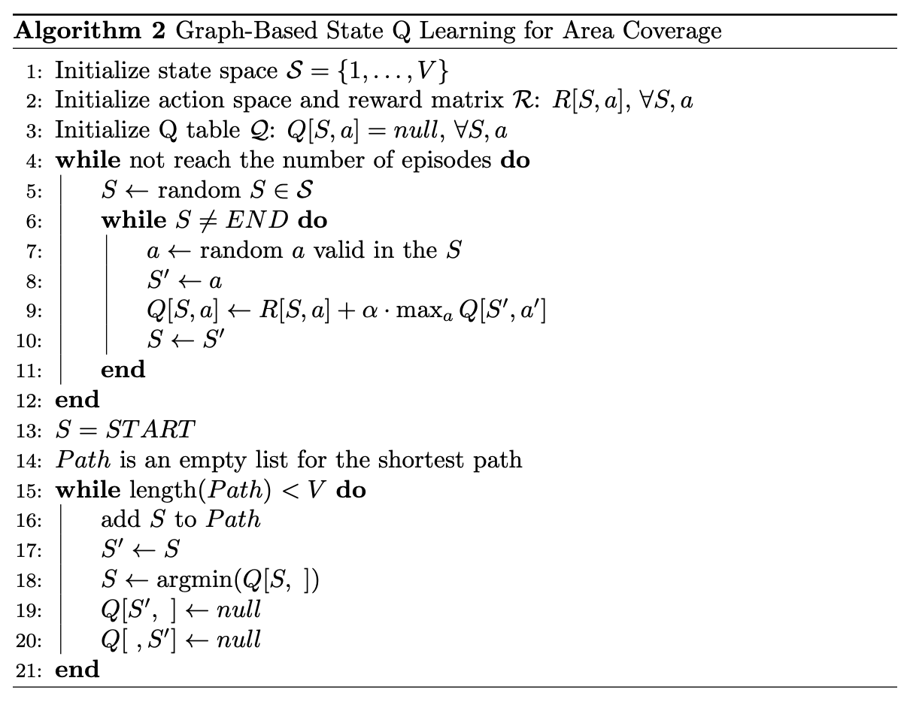
Graph Based MDP Q Learning
Link

Slide 8
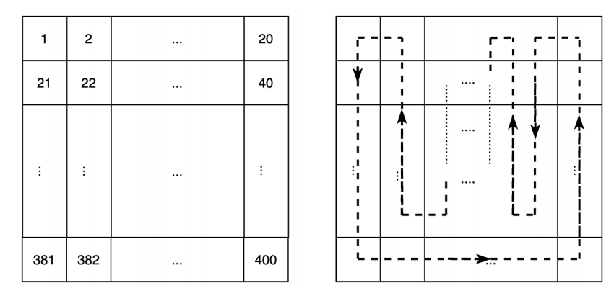
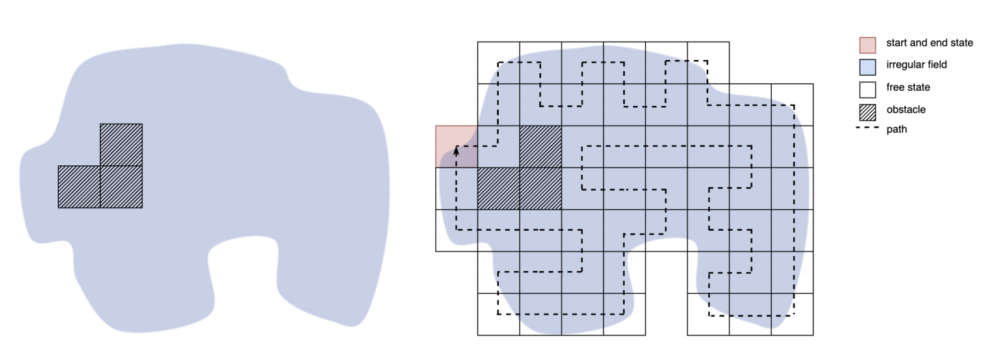
Graph Based MDP Q Learning Examples Results
Solution of coverage path in an irregular field environment
20x20 graph of gridworld and the solution for its coverage path planning

Slide 9
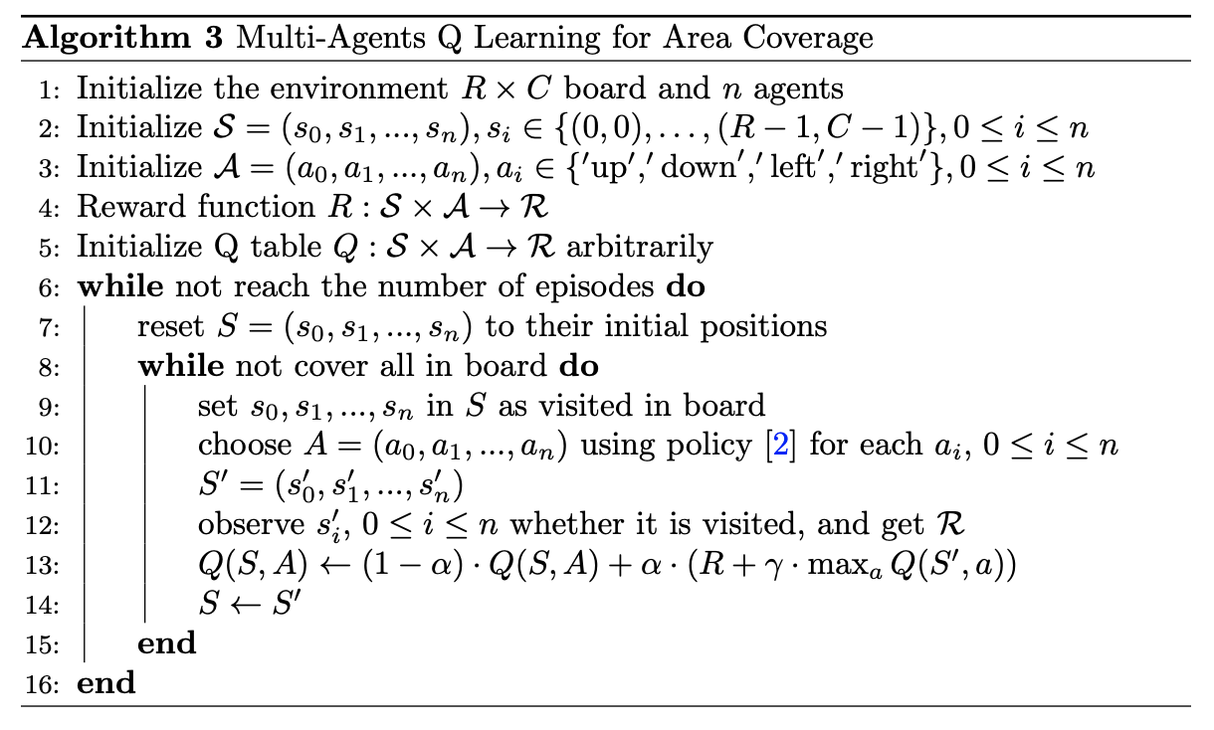
Multi-Agents Q Learning

Slide 10
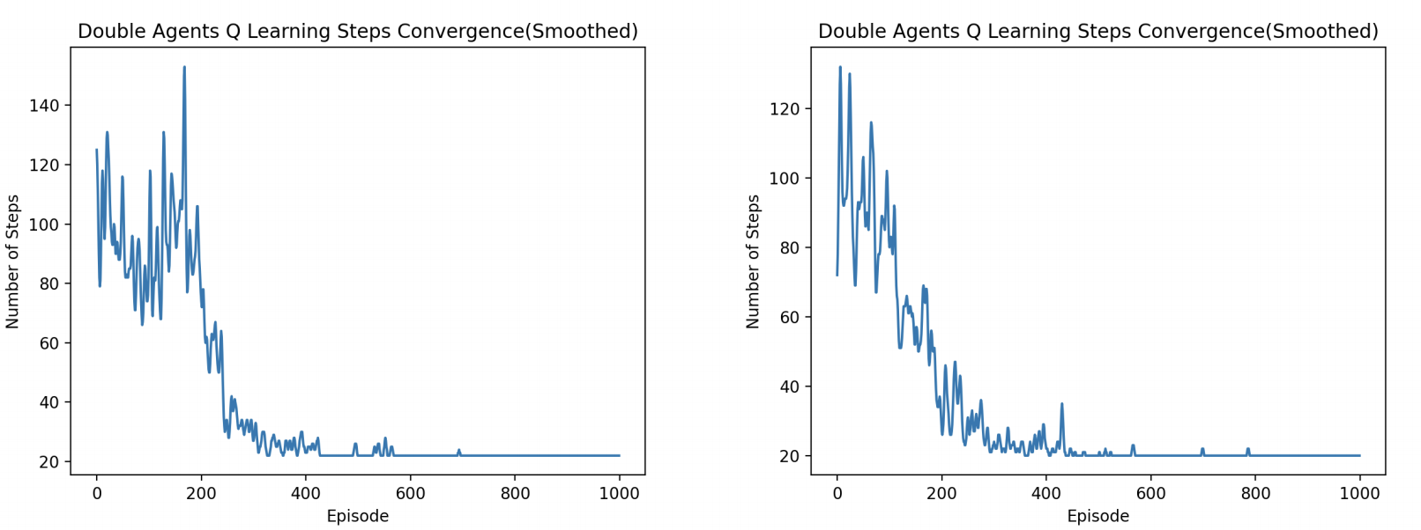
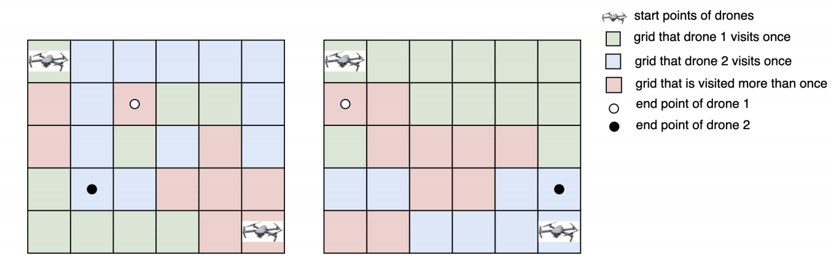
Multi-Agents Q Learning
Find a path covered all cells in a relative some steps, but not the best path
Link

Slide 11



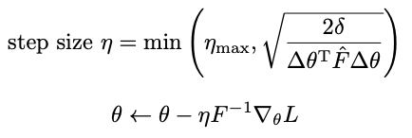
Actor Critic using Kronecker-Factored Trust Region(ACKTR)
Actor:
Fisher matrix defined by policy distribution(multi-layer perception(MLP) policy in our case):
Critic:
v, defined to be a Gaussian distribution
Apply Kronecker-factored approximated curvature(K-FAC)
Apply Trust Region optimization of K-FAC for natural gradient

Slide 12
Actor Critic using Kronecker-Factored Trust Region(ACKTR)
Implementation in Stable Baseline in Python:
'''
Basic Structure, for more, LINK
'''
env = GridWorldEnv(width, height)
env = Monitor(env, 'path')
env = make_vec_env(lambda: env, n_envs=1)
model = ACKTR('MlpPolicy', env, verbose=1, learning_rate=0.15).learn(100000, callback=callback)
obs = env.reset()
for steps in range(width * height // 2):
action, _ = model.predict(obs, deterministic=True)
Obs, reward, done, info = env.step(action)

Slide 13
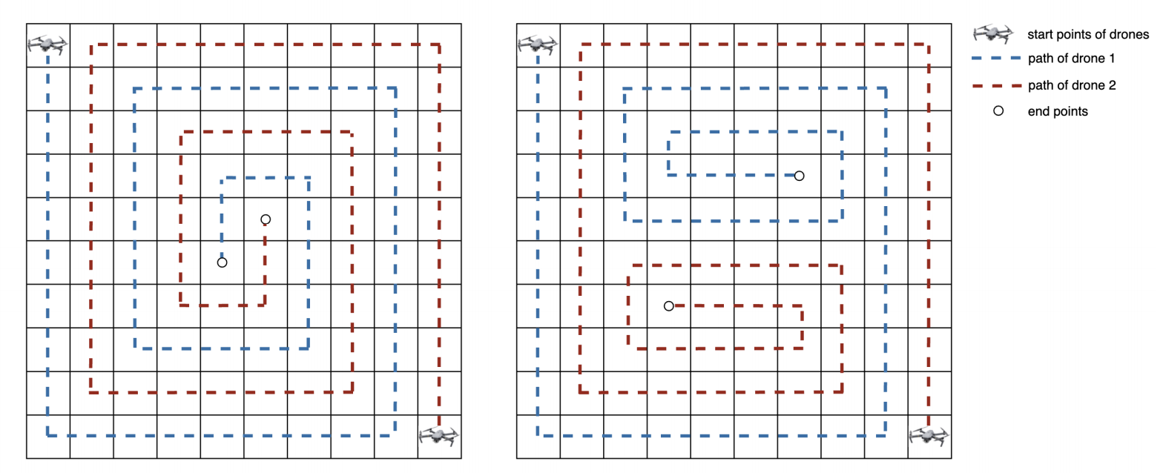
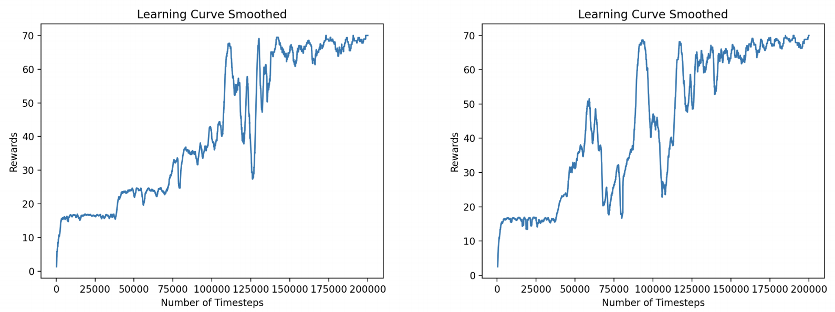
Actor Critic using Kronecker-Factored Trust Region(ACKTR)
Simulation

Slide 14
Conclusion and Future Work
In this summer research, we design and implement efficient NMDP and MDP tabular Q learning for single drone coverage in a given regular or irregular environment, built in Gym or by graph; and ACKTR deep reinforcement learning for the double agents cooperatively learn to provide full coverage in the gridworld by stable baselines. The experimental results show that our reinforcement learning agents successfully learn to finish the coverage for both single and double agents, and come back to the launch position for the single agent. In the future, we are interested in using more Deep Learning methods to increase the size of the environment that can be covered with a more stable convergence, and extend it to the multi-agent systems. We will also consider energy, resolution, e.t.c. constraints in the UAV coverage in solving real life problem, such as wildfire monitoring, search and rescue missions, and so forth.

Slide 15
Acknowledgement
This research project is funded by MacKnight-Haan-Ludwig Summer Research Collaboration Fund, Class of 1950 Summer Research Collaboration Fund, Anderson-Grossheusch Summer Research Collaboration Fund, and Mac/Faculty Collaboration Summer Research Funds. The author would like to appreciate the insightful discussion and work with Macalester College professor Esra Kadioglu, and students Aaron Gould, Elisabeth Landgren, and Fan Zhang.

Slide 16
THANK YOU

